Slide 1


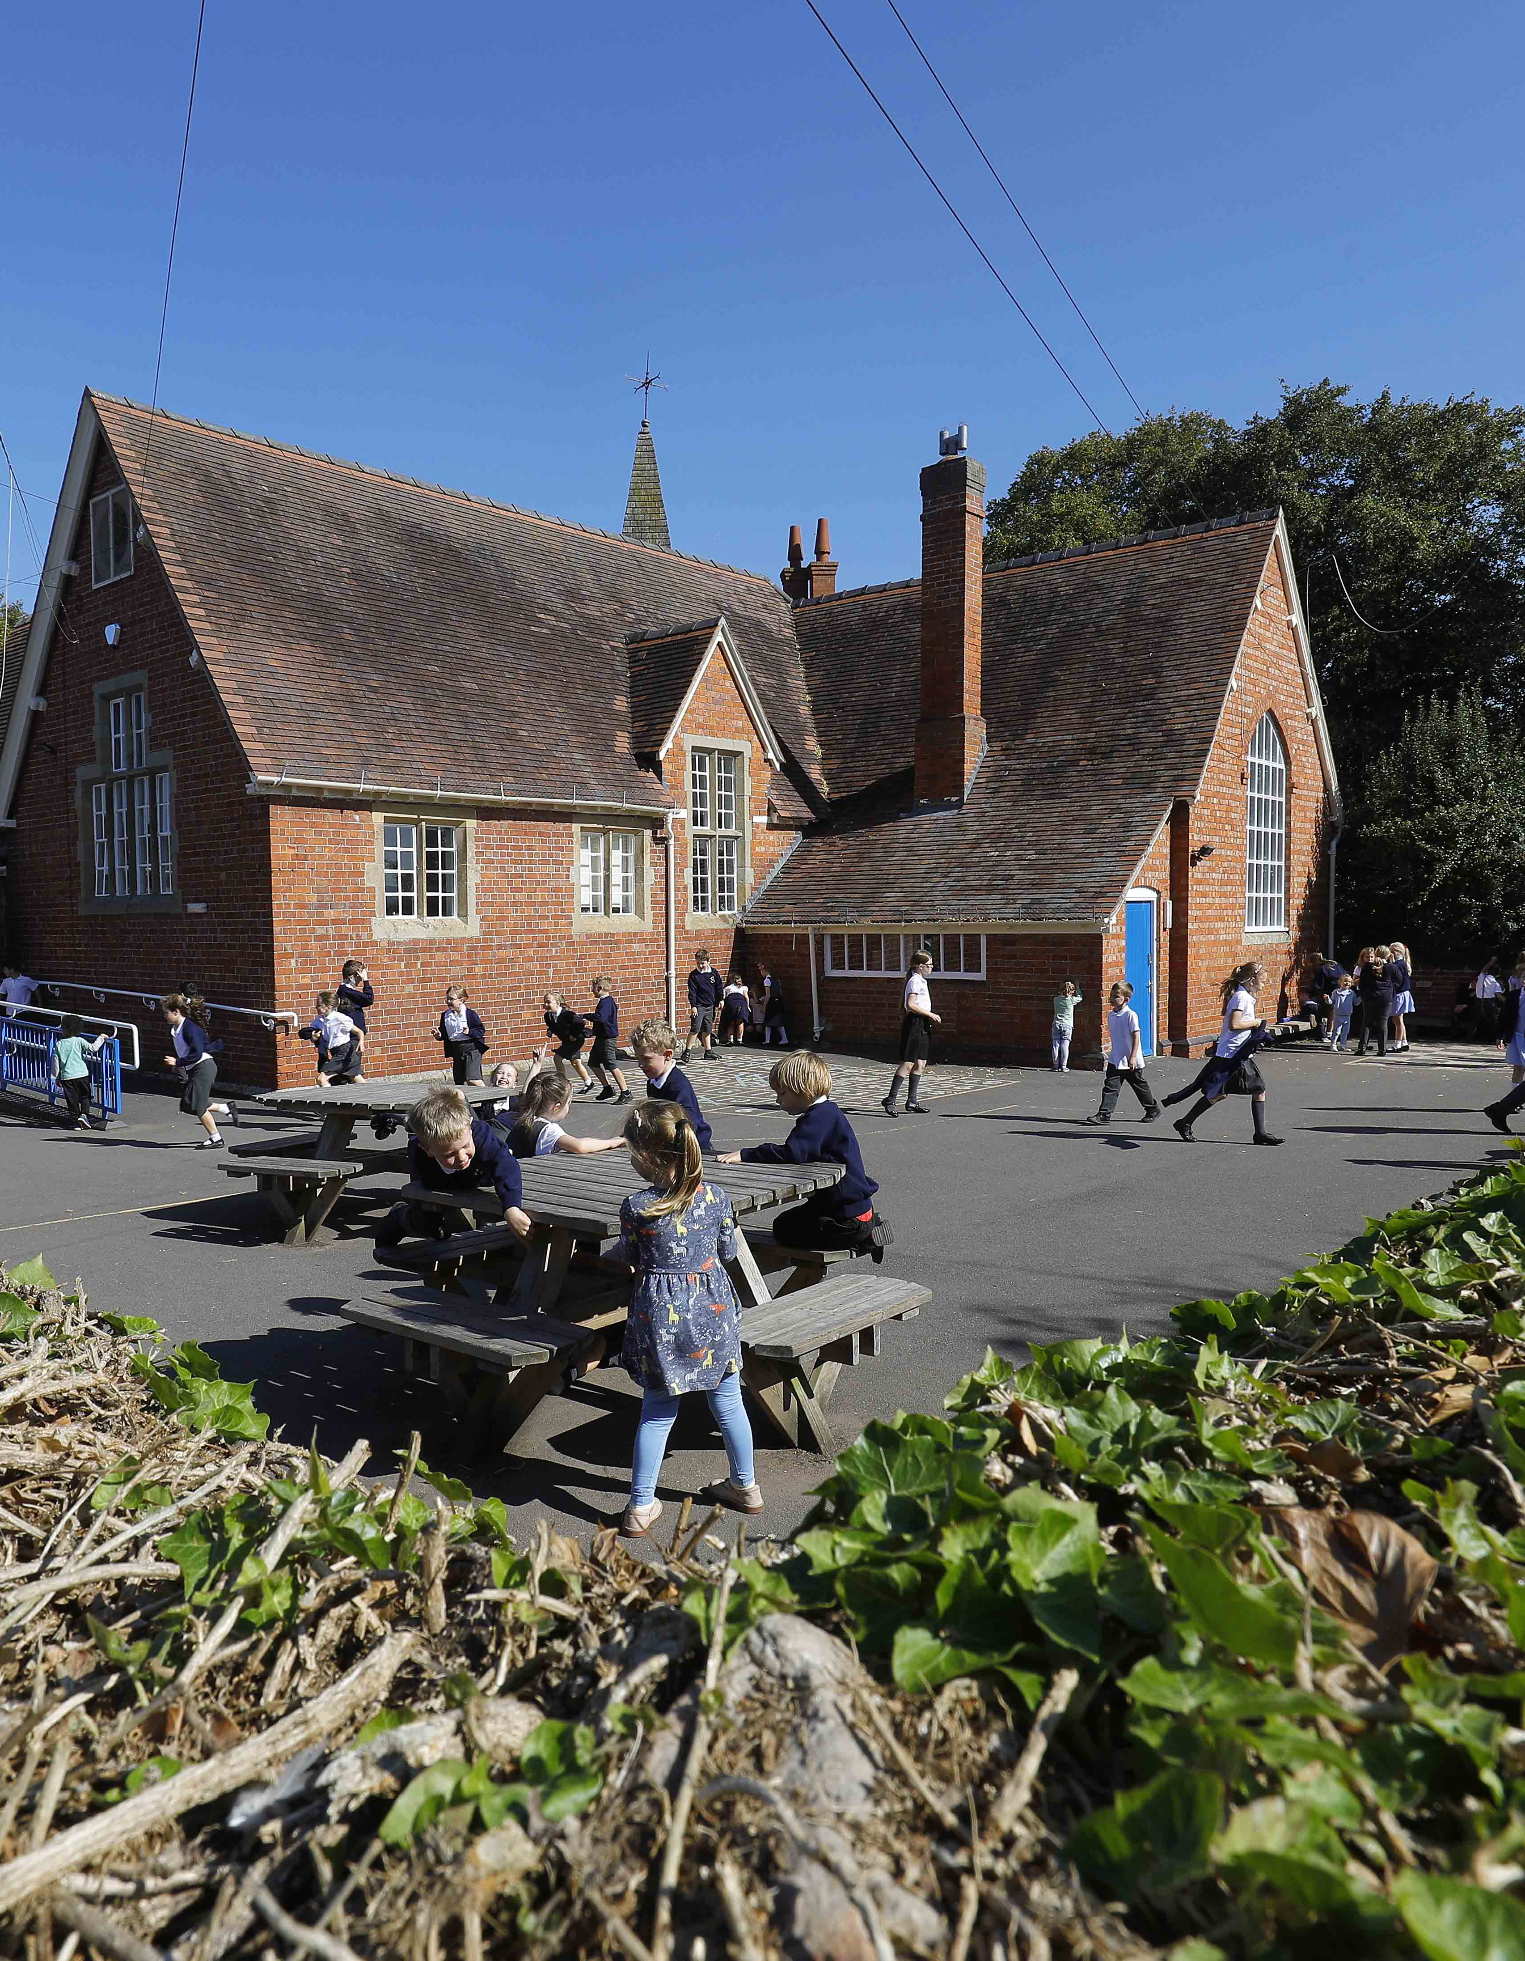
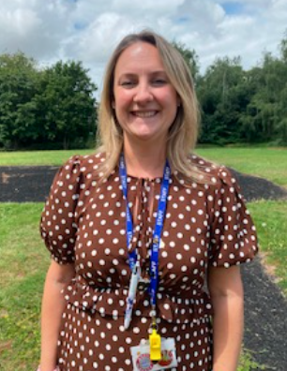

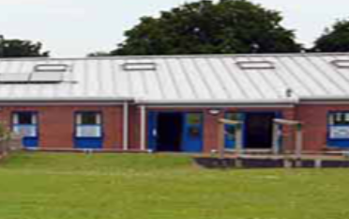
High Ercall Primary School
Welcome to our lovely village primary school.
We hope that this PowerPoint will help you find out more information about starting our school in Reception.
Mrs Gemma Lingham
Acting Headteacher

Slide 2
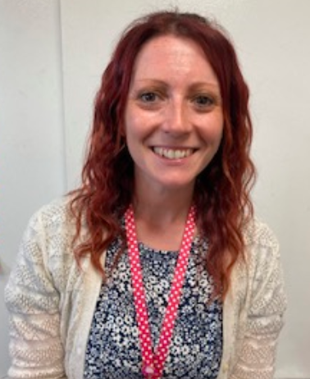
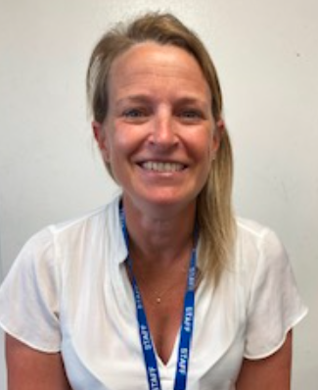
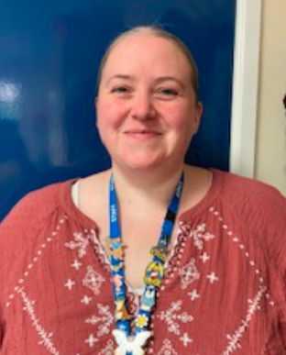
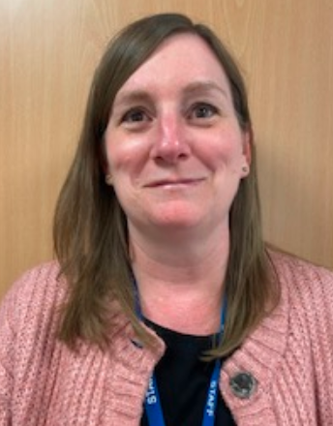
Class Teachers
Mrs Wallace
Tues- Fri
Mrs Bane Monday
Teaching
Assistants
Miss Young
Mrs Jones

Slide 3
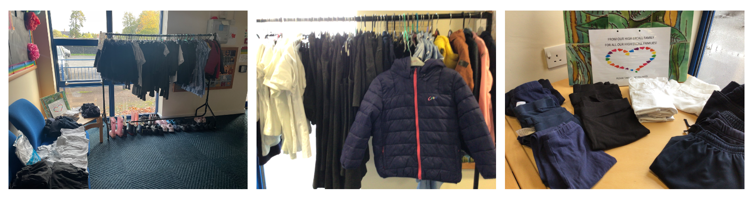


Uniform
29 New St, Wellington, Telford TF1 1LU
Schoolwear Shropshire | Baker & Sons Schoolwear

Slide 4

What children need to bring to school:
Every day children will need to bring their reading packet, a water bottle, a healthy snack and their coat.
Healthy snacks are also provided by school.
Payments and notes from home can be handed over in these bags.
Please make sure all belongings are labelled.

Slide 5
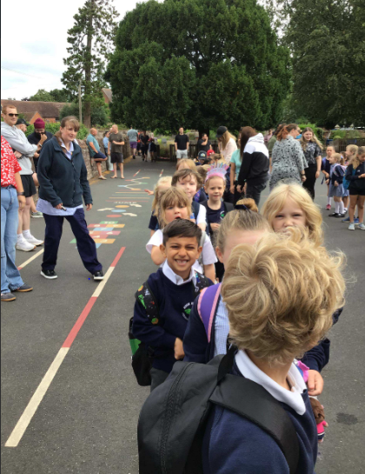
Coming into school
The children come into class at 8.45am
Class 1 line up on the playground in the mornings and staff will come to collect them and bring them into the classroom.

Slide 6
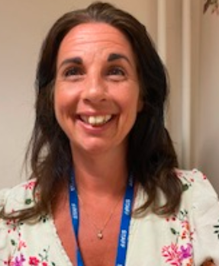
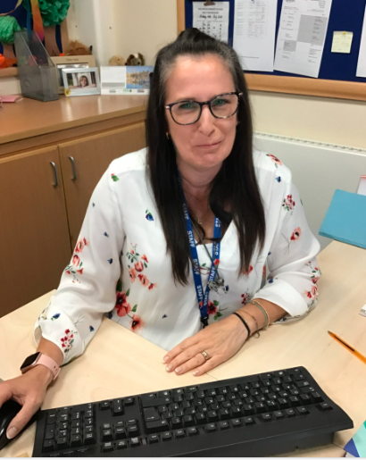
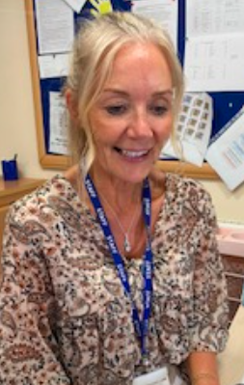
Arriving at Other Times
If you are late or are returning to school after an appointment, please take your child to the main reception.
Please tell Mrs Machin Mrs Hadley or Mrs Luckman so they can amend the register for the day.

Slide 7
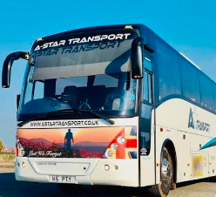
Collection from the School Transport
Children who travel by coach to school using school transport are collected by members of staff and taken directly to their classroom. Likewise, children are escorted from school onto the coach at the end of the day. Seat belts and seating is checked before departing. Along with the driver, there is currently a chaperone on the coach.
Telford & Wrekin Council | School travel assistance
You can only apply if you are in the catchment area – over 2 miles from school.

Slide 8

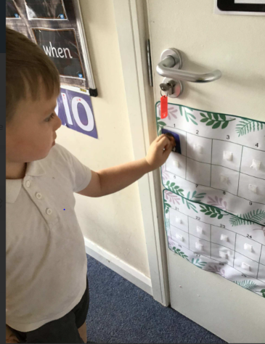
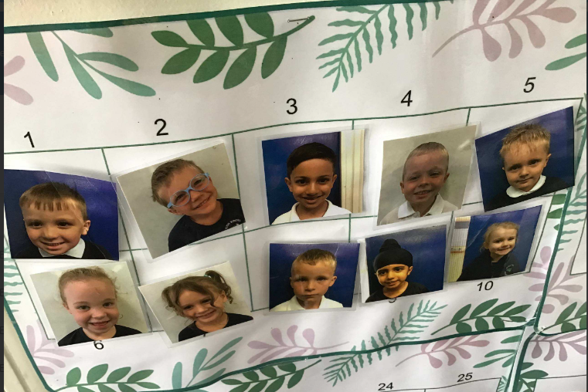

Self-Registration

Slide 9
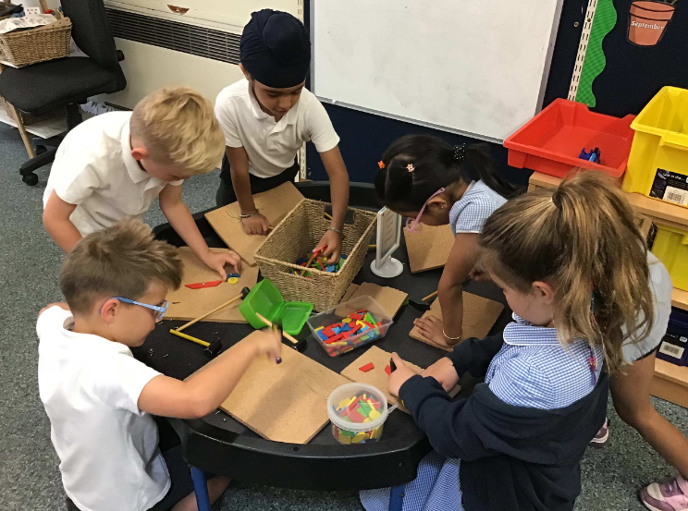
Early Morning Activities
Each morning a range of activities are on offer to the children.
These help to settle your child into the school day.
Notes:
Now choose and activity that is on a table top or in the outside learning area

Slide 10

Active Learn-Phonics and Reading
Children have daily phonics and reading sessions.
They will bring home weekly information about what sounds they have learnt in phonics. The books they bring home will contain the sounds they have learnt.
You can help by practicing these sounds at home. We will have a workshop for parents and carers at the beginning of the year where you can find out more about how to support your child.

Slide 11
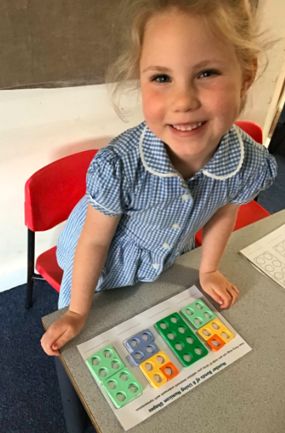
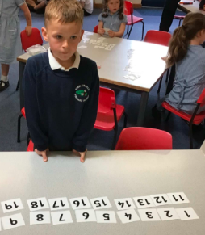
Maths-Number Sense

Slide 12
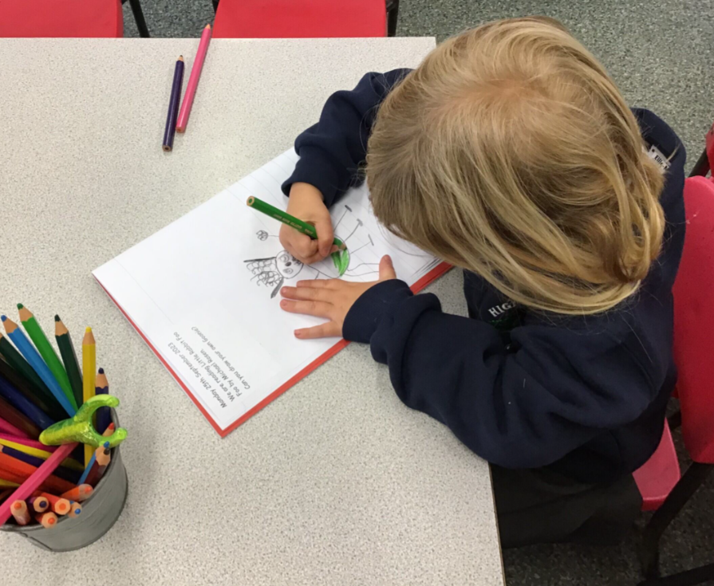





Vocabulary

Slide 13
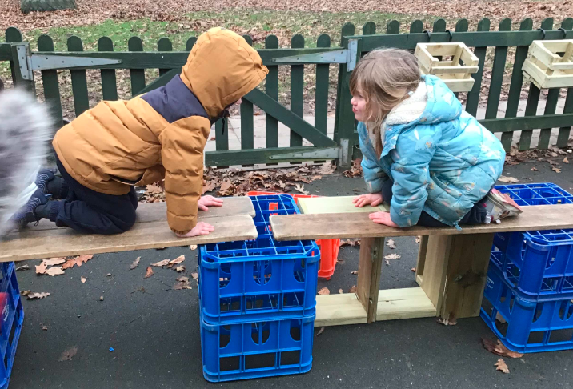
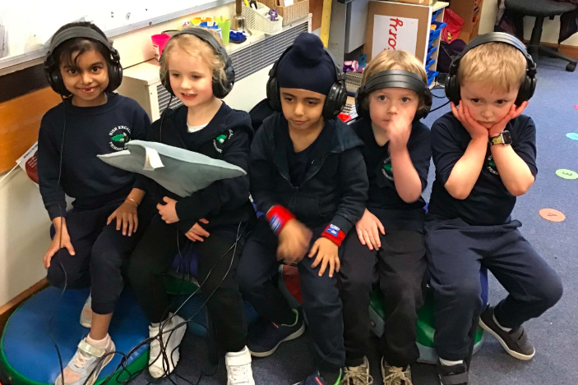
The children use the indoor and outdoor environment to develop skills, build on their learning and try new ideas out. It is changing all the time to meet the children's needs.
Continuous Provision and Enhanced Learning

Slide 14
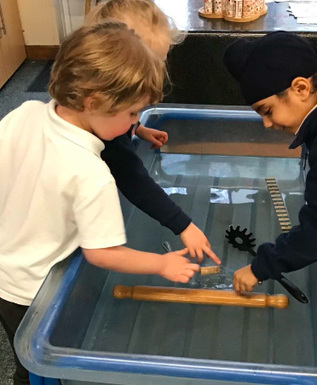
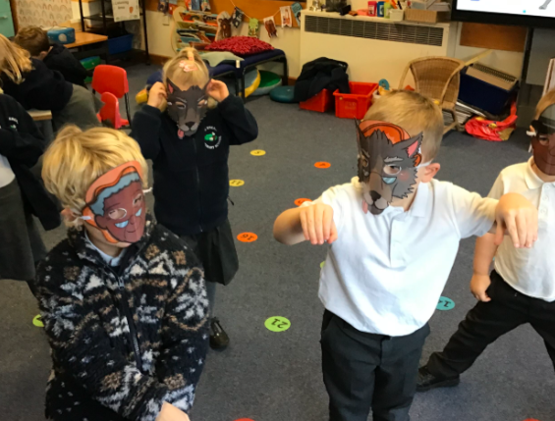
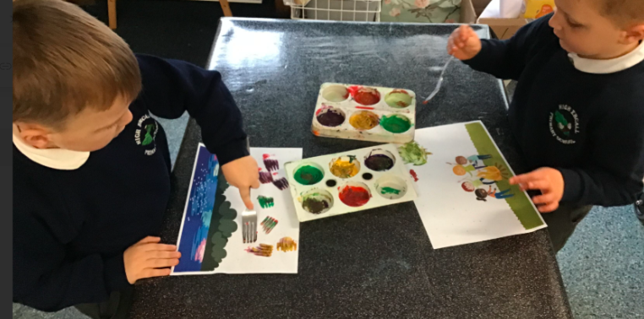

Slide 15
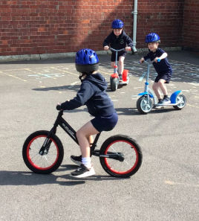
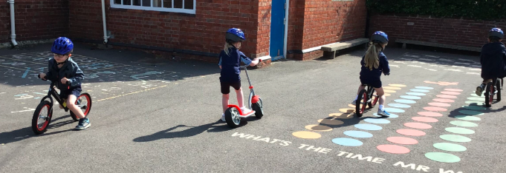
Outdoor physical play

Slide 16
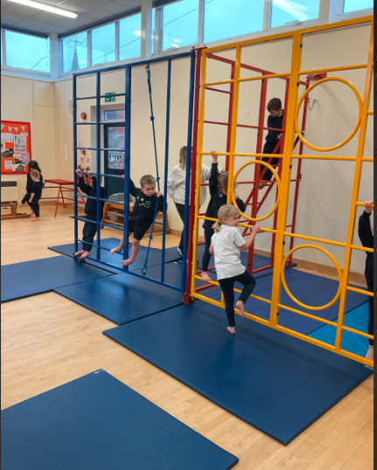
P.E.
Children take part in P.E. once a week.
We have a school PE kit which includes a school hoodie and navy joggers, or shorts. Children come in their PE kit on PE and Forest School days.

Slide 17



Assembly
We have an assembly each day, some are in classes and some are in the hall.
We have stories, songs, time to reflect and celebrate the children’s achievements.

Slide 18
Lunch
All children in Reception, Years 1 and 2 are entitled to have a free school lunch. They can still bring sandwiches from home, if they want.
Children are offered a choice of healthy cooked meals prepared in the school kitchens.
Children collect a tray and cutlery and choose their lunch.
There are Lunch Time Supervisors to help.

Slide 19
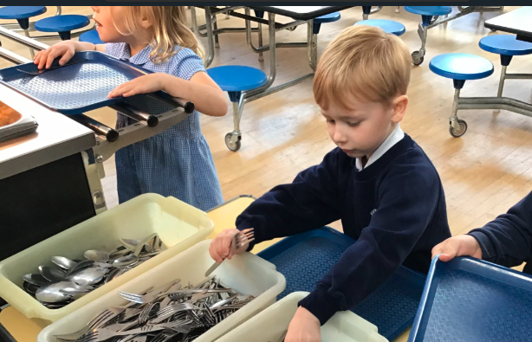
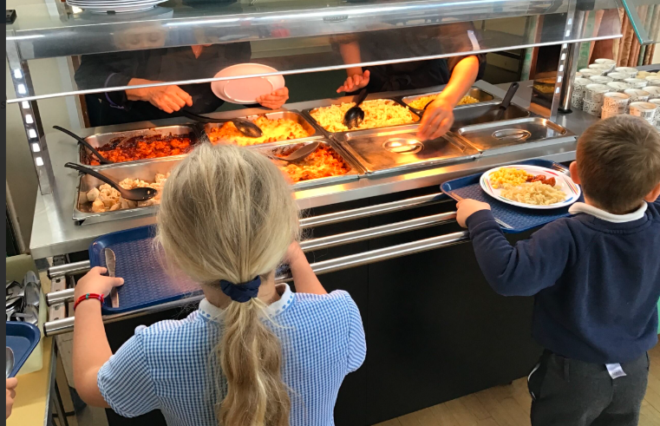
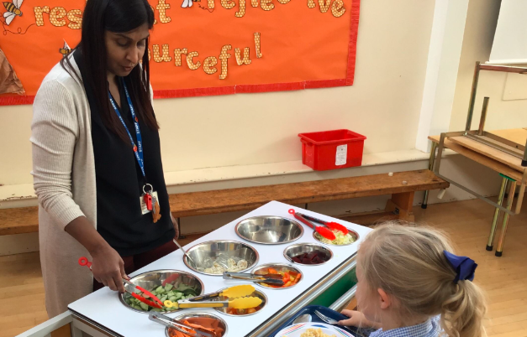
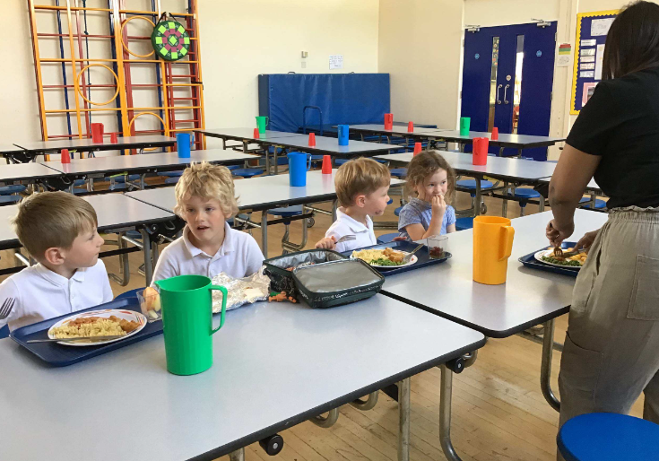

Slide 20
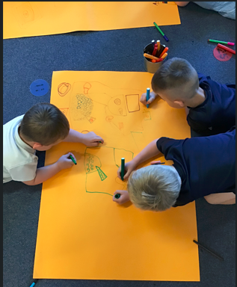
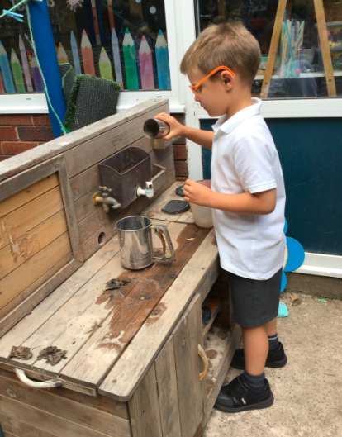
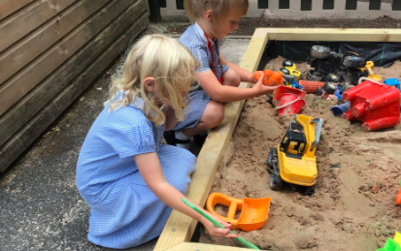
Afternoon Learning
Young children learn best through play.
We set, and they often set themselves challenges and problems to solve.
They are able to share their learning, talk about what’s gone well and how they have overcome difficulties.

Slide 21
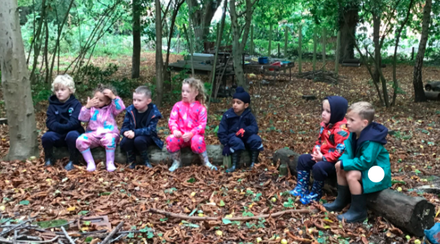
Forest School
We have amazing school grounds and a dedicated forest area for learning and play which is used by all classes.

Slide 22


Outdoor Clothing
This year we are asking for each child to keep a bag in school of clothing for outdoor learning. This should include wellies and a waterproof cover up. This will be sent home at the end of every half term. This will be for Forest school and playing outside. Whatever the weather.
Please label these and the bag they are in. Please teach your child to put on the waterproofs independently before school starts.

Slide 23
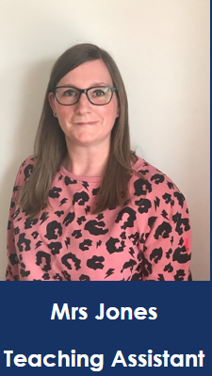
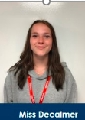
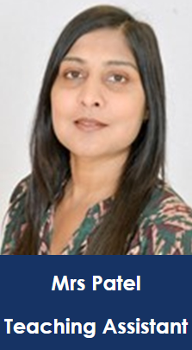
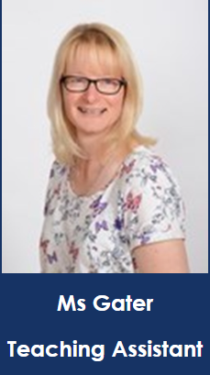
If your child needs before or after school care, we run a Rise and Shine club before school and Chill club after school.
Mrs Jones and Miss Decalmer are in Rise and Shine from 7.50am £4.00per session.
Mrs Patel and Ms Gater run Chill Club until 5.30pm per session or £4.00 to 4.15pm. £8.50 to 5.30pm
Extended schools provision

Slide 24
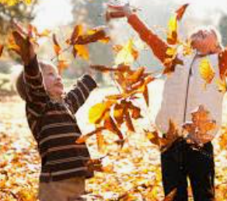
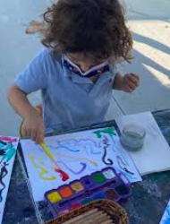


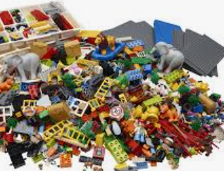
Extended School Clubs
Clubs run from 3.15-4.15pm
Monday: Storytime
Tuesday: Youth Club
Wednesday: Indoor Sport
Thursday: Multi Skills
Friday: Fun Club

Slide 25




FHEPS:
Bingo
Disco
200 Club
easyfundraising
Join the committee

Slide 26
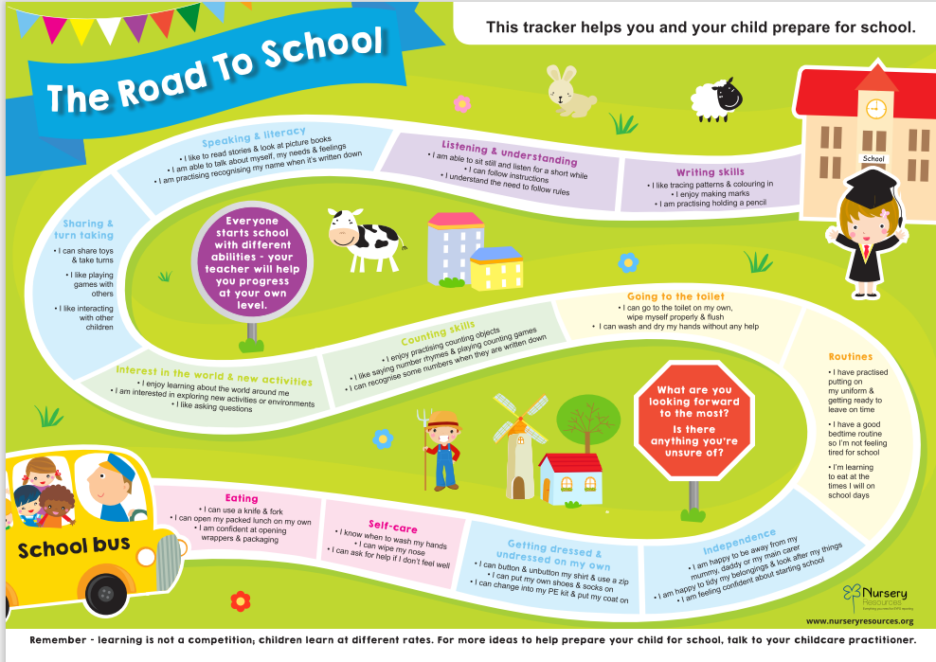

Slide 27
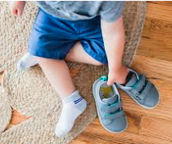


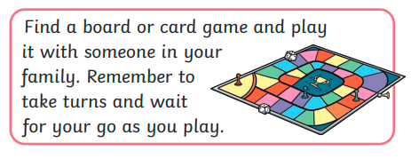
Summer Challenges
How quickly can you put on your shoes and socks? Can you get quicker over the weeks?
Learn a new Nursery Rhyme. Perform it to the people you live with.
Tell us about a day out- send or draw some pictures.
Build a model out of construction; tell a grown up about it.

Slide 28


Slide 29


